Slide 1
Face Liveness Detection

Slide 2
Introduction
1)Company/firm’s name: SimpleCRM, Nagpur.
2)Mentored by: Mr Saurabh Shahare.
3)Title: Face Liveness detection.
4)Objective: For development of anti-spoofing solutions for Ekyc platforms and face recognition systems.

Slide 3
Index
1) Start - Viola-jones algorithm.
2) Artificial Neural Network.
3) Convolutional Neural Network.
4) Liveness Detection.
5) Additional Characteristics.
6) Eye Aspect Ratio.
7) Further Work.

Slide 4
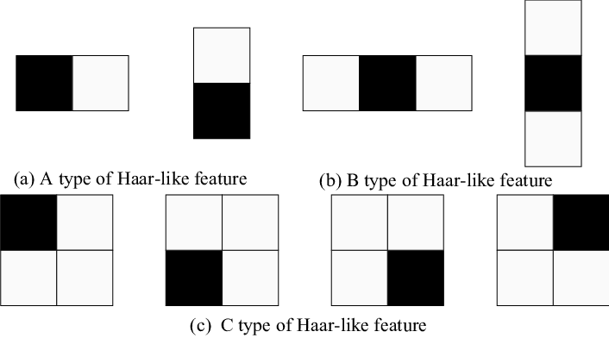
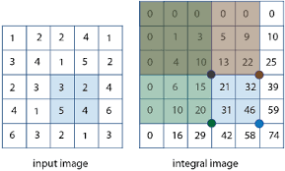
Viola Jones Algorithm
1. It uses Haar-Like Features to detect parts of a face:
2. The Viola Jones Algorithm compares how close the real
World scenario is to the ideal Haar-like feature.
3. The algorithm makes use of integral images to reduce
effort while comparing two regions.
4. Training classifiers are used to set thresholds above which a certain area of the face will be considered a Haar feature.
5. This is done by converting the image into a 24x24 image and once these features are found, they are magnified and their proportions are changed.

Slide 5
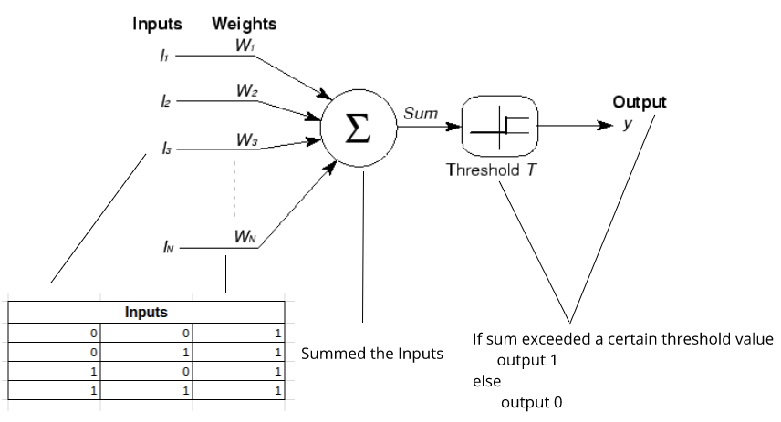
Artificial Neural Networks

Slide 6
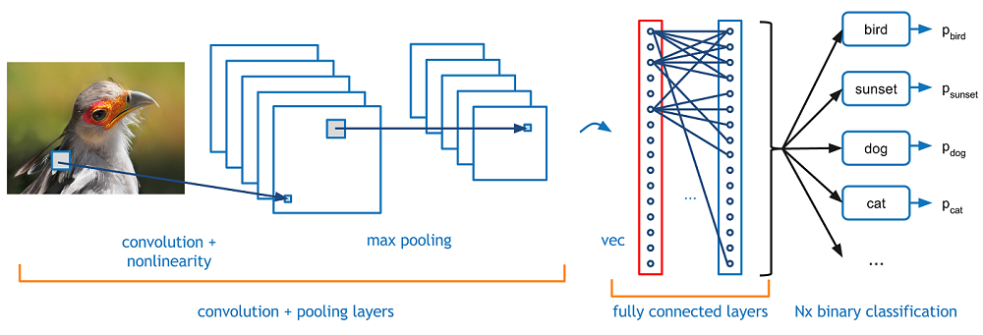
Convolutional Neural Networks

Slide 7
Liveness Detection using CNN
It can be divided into three parts:
1. Extracting regions of interest (images) from videos (two videos – fake and real) that are provided by the user frame wise and storing them as two different training datasets.
2. Using these datasets to train a Convolutional Neural Network to identify whether the frames provided by the live video camera are real or fake based on the training it received (binary classification problem).
3. Starting a live video stream and analysing it frame wise with the help of the trained CNN.

Slide 8
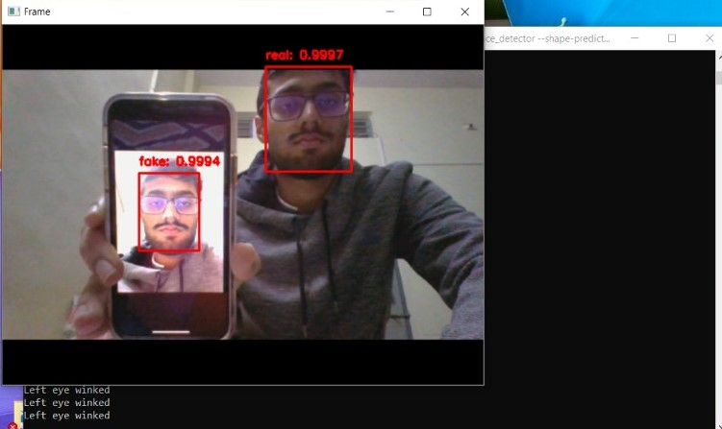

Slide 9
Additional Characteristics
The model showed inaccuracies when it was trained with videos of a person who belonged to one ethnicity, but was asked to predict the liveness of a person of another ethnicity.
Hence, in order to increase its accuracy, some other features were also considered alongside the result of the CNN. These features were to be added as an ‘and’ condition i.e. both the result of the CNN and this additional feature would have to be positive in order for it to show the person as live. The concepts that we used was:
Hough Circle Detection for the eyes.
The Eye-Aspect ratio using dlib.

Slide 10
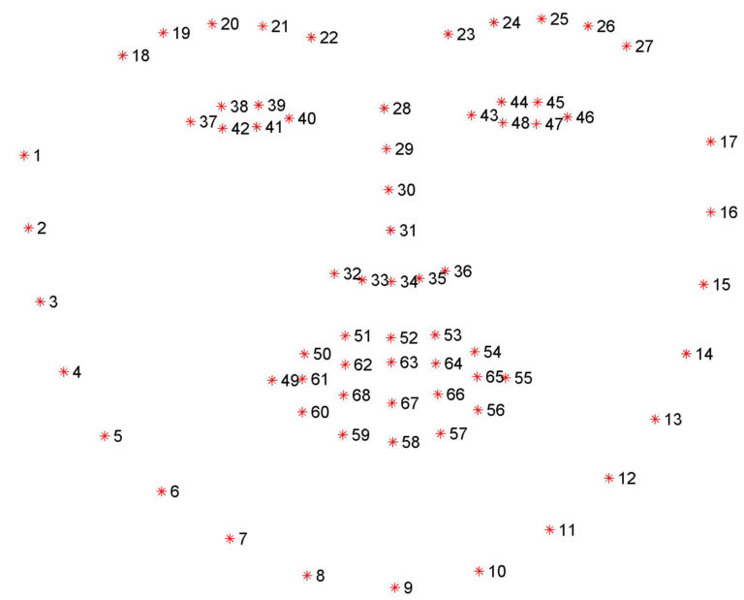
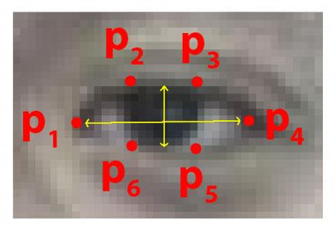
Eye Aspect Ratio
Eye-Aspect Ratio or EAR is based on the concept of facial landmarks. These are used to detect particular parts of the face, (the eyes) in this case.
Detecting facial landmarks is a subset of the shape prediction problem. Given an input image (and normally an ROI that specifies the object of interest), a shape predictor attempts to localize key points of interest along the shape. It is a two step process:
Detecting the face
Detecting the key features in the face ROI (Region of Interest)

Slide 11
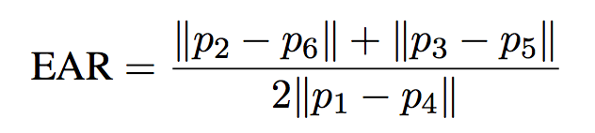
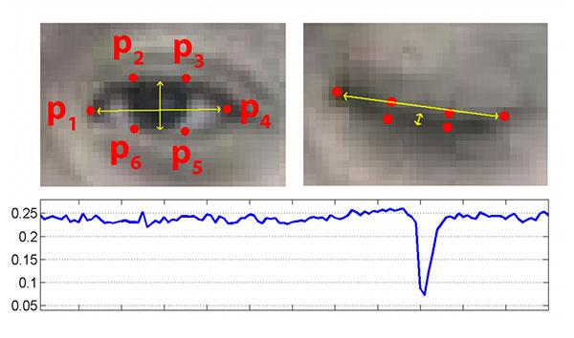
The threshold set for this function was 0.30. Once again, this was combined with the initial result of the Convolutional Neural Network to try to produce a more accurate result. This is what we are currently working on.

Slide 12
Future Work:
In addition to combining both EAR and the result of the CNN, we are also searching for better options to enhance the liveness detection model.
Also, we developed a server that can be used to showcase this model to other users over the internet.

Slide 13
Thanks to Mr.Saurabh Shahare from
Simple CRM for his valuable guidance and mentorship.

